Slide 1
Spring Batch By Apparao

Slide 2
Spring Batch Introduction:
Many applications within the enterprise domain require bulk processing to perform business operations in mission critical environments.
These business operations include automated, complex processing of large volumes of information that is most efficiently processed without user interaction.
These operations typically include time based events (e.g. month-end calculations, notices or correspondence), periodic application of complex business rules processed repetitively across very large data sets (e.g. Insurance benefit determination or rate adjustments), or the integration of information that is received from internal and external systems that typically requires formatting, validation and processing in a transactional manner into the system of record.
Batch processing is used to process billions of transactions every day for enterprises.
Spring Batch is a lightweight, comprehensive batch framework designed to enable the development of robust batch applications vital for the daily operations of enterprise systems.
Spring Batch is not a scheduling framework.
There are many good enterprise schedulers available in both the commercial and open source spaces such as Quartz, Tivoli, Control-M, etc.
It is intended to work in conjunction with a scheduler, not replace a scheduler.

Slide 3
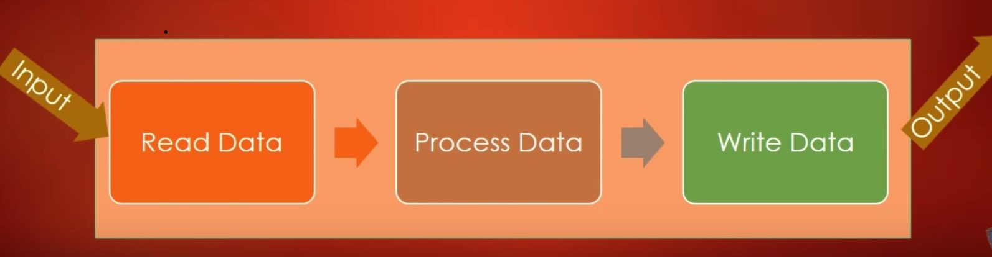
Batch Job: A Batch job reads data, processes it and writes processed data in specified format.

Slide 4
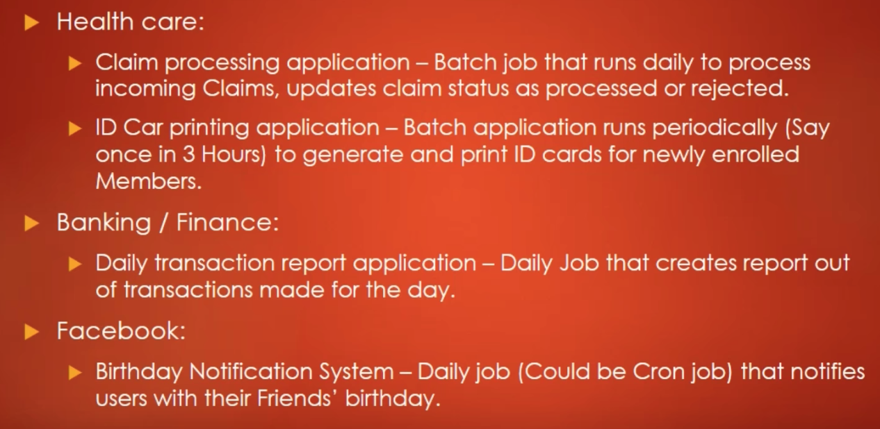
Examples:

Slide 5
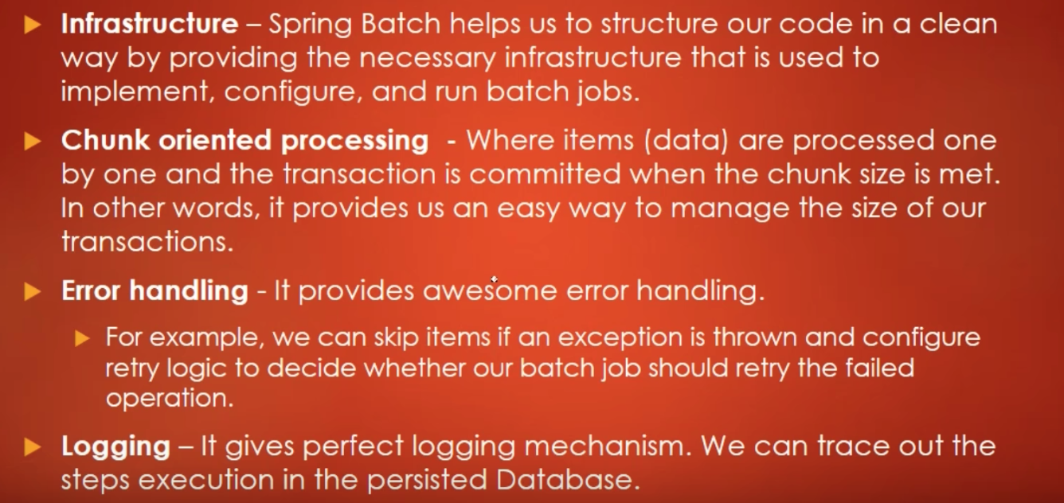
Spring Batch Advantages

Slide 6
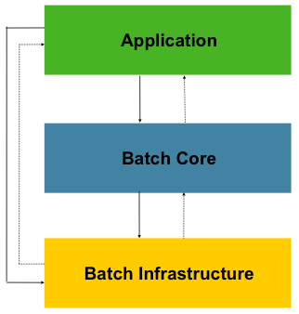
Spring Batch Architecture

Slide 7
This layered architecture highlights three major high level components: Application, Core, and Infrastructure.
Application: The application contains all batch jobs and custom code written by developers using Spring Batch.
Batch Core: The Batch Core contains the core runtime classes necessary to launch and control a batch job. It includes things such as a JobLauncher, Job, and Step implementations.
Both Application and Core are built on top of a common infrastructure.
Batch Infrastructure: This infrastructure contains common readers and writers, and services such as the RetryTemplate, which are used both by application developers(ItemReader and ItemWriter) and the core framework itself.

Slide 8
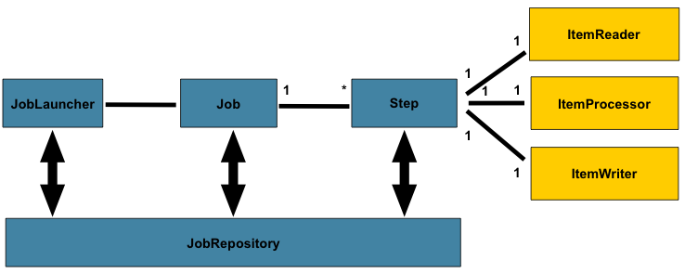

Slide 9
JobLauncher:
JobLauncher represents a simple interface for launching a Job with a given set of JobParameters:
public interface JobLauncher {
public JobExecution run(Job job, JobParameters jobParameters)
throws JobExecutionAlreadyRunningException, JobRestartException;
}
It is expected that implementations will obtain a valid JobExecution from the JobRepository and execute the Job.

Slide 10
JobRepository:
It provides CRUD operations for JobLauncher, Job, and Step implementations.
When a Job is first launched, a JobExecution is obtained from the repository, and during the course of execution StepExecution and JobExecution implementations are persisted by passing them to the repository:

Slide 11
